Slide 1
Hypothesis Testing
"Parametric" tests – based on assumed distributions (with parameters).
You assume Normal distributions (usually)
in ways detailed below
These standard tests are useful to know, and for communication, but during your analysis I recommend more robust eyeball checking of significance – scramble the data, split it in halves/thirds, make syntehtic data, etc. etc.
Notes:
Today’s lecture treats the subject of interpolation.

Slide 2
purpose of the lecture
to introduce
Hypothesis Testing
the process of determining the statistical significance of results

Slide 3
Part 1
motivation
random variation as a spurious source of patterns

Slide 4
d
x

Slide 5
looks pretty linear
d
x

Slide 6
actually, its just a bunch of random numbers!
figure(1);
for i = [1:100]
clf;
axis( [1, 8, -5, 5] );
hold on;
t = [2:7]';
d = random('normal',0,1,6,1);
plot( t, d, 'k-', 'LineWidth', 2 );
plot( t, d, 'ko', 'LineWidth', 2 );
[x,y]=ginput(1);
if( x<1 )
break;
end
end
the script makes plot after plot, and lets you stop when you see one you like

Slide 7
the linearity was due to random variation
Beware:
5% of random results will be
"significant at the 95% confidence level"!
The following are "a priori" significance tests.
You have to have an a priori reason to be looking for a particular relationship to use these tests properly
For a data "fishing expedition" the significance threshold is higher, and depends on
how long you've been fishing!

Slide 8
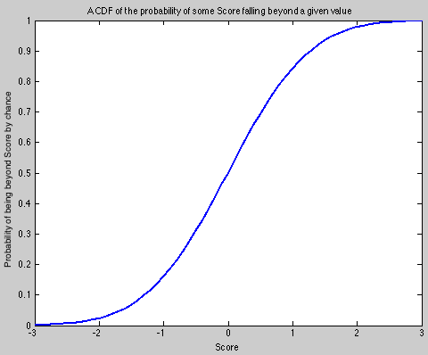
The p-value is an aspect of a CDF.
The art of hypothesis testing is this:
Express the likelihood of your Data Result being true, in a relevant null hypothesis-generated random dataset, in terms of a single number -- a score.
Once the scoring is defined, the game is on!
p=0.95
(or 0.05)
p=0.95
(or 0.05)
A result with abs(Score) > 1.8 is verbalized as"significant with 95% confidence"
in this example (a two-tailed test whose null hypothesis is: Score=0)

Slide 9
Four Important Distributions used in hypothesis testing

Slide 10
#1: The Z Score p(Z) is the Normal distribution for a quantity Z with zero mean and unit variance (standardized Normal distribution)

Slide 11
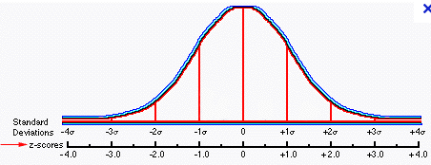
if d is Normally-distributed with mean d and variance σ²_{d}
then Z = (d-d)/ σ_{d} is Normally-distributed with zero mean and unit variance
The "Z score" of a result is simply "how many sigma away from the mean” is that result

Slide 12
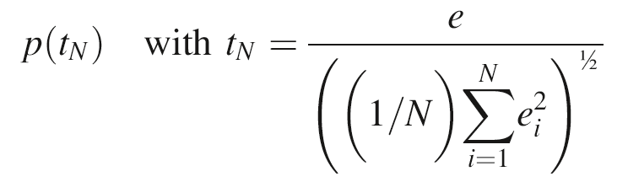
#2: The t Score: t_{N} is the distribution of a finite sample (N) of values e that are Z distributed in reality
this is a new distribution, called the
"Student's t-distribution".
For large N, the denominator asymptotes to σ_{e}=1, so t∞= Z

Slide 13
t-distribution
N=5
p(t_{N})
N=1
t_{N}
Notes:
Student’s t-probability density function for N=1, 2, 3, 4, and 5.

Slide 14
t-distribution
becomes Normal p.d.f.
for large N
N=5
heavier tails than a
Normal p.d.f.
for small N *
p(t_{N})
N=1
N=1
t_{N}
*because you mis-estimate the mean with too few samples. As a result, a value
far from the (mis-estimated) mean is far more likely.
Notes:
Student’s t-probability density function for N=1, 2, 3, 4, and 5.

Slide 15
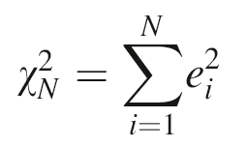
#3 The chi-squared distribution
Chi-squared χ_{N}² is the distribution of the sum of the squares of N Normally distributed variables.
Its limit as N → ∞ is therefore Normal*...
Except notice that it is positive definite
* recalling the Central Limit Theorem: the Normal or Z distribution arises for the sum of a large (N→∞) number of i.i.d. variables, no matter what their individual distribution.

Slide 16
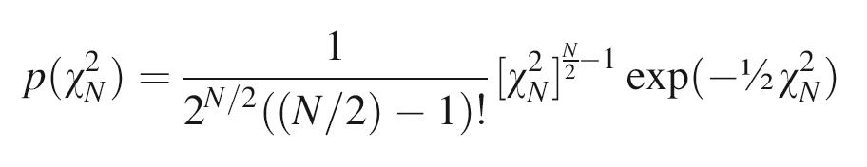
Chi-squared distribution
http://en.wikipedia.org/wiki/Chi-squared_distribution
Q: What kinds of variables do we use that are like this?
A: Energy, variance, SSE (summed squared error).

Slide 17
Chi-squared
total error
E = χ_{N}² = Σ _{i=1}^{N} e_{i}²
p(E) is called 'chi-squared' when e_{i} is Normally-distributed with zero mean and unit variance
called chi-squared p.d.f

Slide 18
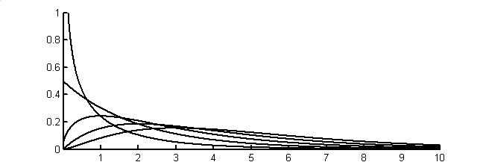
Chi-Squared p.d.f.
PDF of the sum of N squared Normal variables
N called “the degrees of freedom”
mean N, variance 2N
N=1
p(χ_{N}²)
asymptotes to
Normal (Gaussian) shape
for large N
2
3
4
5
χ²

Slide 19
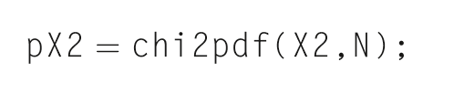
In MatLab

Slide 20
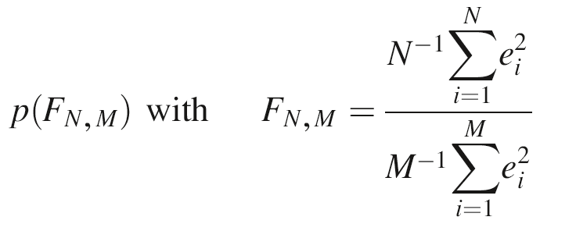
#4 Distribution of the ratio of two variances from finite samples (M,N) (each of which is Chi-squared distributed)
it's another new distribution, called the "F-distribution"

Slide 21
F-distribution
The ratio of two imperfect (undersampled) estimates of variance –
for N,M → ∞ it becomes a spike at 1 as both estimates are right
skewed at low N and M
p(F_{N,2})
N=2
50
F
N=2
50
p(F_{N,5})
F
p(F_{N,25})
N=2
50
F
p(F_{N,50})
N=2
50
F
starts to look Normal, and gets narrower
around 1 for large N and M
Notes:
F-probability density function, p(F_{N,M}), for selected values of M and N.

Slide 22
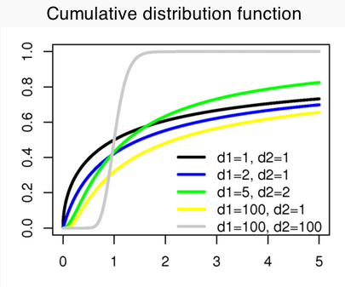
When would we use an F-Score?
Hypothesis: our two variances are truly different, reflecting two different populations (or processes).
Null hypothesis: the two are simply different samples drawn from the same process.
The F Score is the ratio of the two sample variances. The p-value is the confidence you have that this F Score is different from 1.
e.g. Spectral peaks above Red Noise
http://en.wikipedia.org/wiki/F_distribution

Slide 23
Part 4
Hypothesis Testing

Slide 24
Step 1. State a Null Hypothesis some version of the result is due to random or meaningless data variations (too few samples to see the truth)

Slide 25
Step 1. State a Null Hypothesis some variation of the result is due to random variation
e.g.
the means of the Sample A and Sample B are different only because of random variation

Slide 26
Step 2. Define a standardized quantity that is unlikely to be large when the Null Hypothesis is true

Slide 27
Step 2. Define a standardized quantity that is unlikely to be large when the Null Hypothesis is true
called a “statistic” or Score

Slide 28
A Null Hypothesis example:
You sample a quantity q in two different places.
2. You hypothesize (admit it, you hope) that these samples indicate a Difference that your science fame will come from.
3. The Null Hypothesis should nullify your hopes: not their opposite (which could be exciting too), but their nullification. Perhaps that your work is unable to even distinguish whether there is a real difference.
4. Score it: the difference in the means Δq=(mean_{A} – mean_{B}) is unlikely to be large (compared to the standard deviation) if the Null Hypothesis (that sample A and B are not really distinguishable) is true.

Slide 29
Step 3. Calculate the probability that the observed value or greater of the statistic would occur if the Null Hypothesis were true

Slide 30
Step 4. Reject the Null Hypothesis if such large values have a probability of ocurrence of less than 5% of the time NOTE: This is not the same as verifying your hypothesis in all its details!! NOTE2: 1 in 20 results will fail to reject the null hypothesis, even if it is true! (how many times did you try that? http://xkcd.com/882/)

Slide 31
An example
test of a particle size measuring device
Notes:
This is just a hypothetical example.

Slide 32
manufacturer's specs:
* machine is perfectly calibrated so
particle diameters scatter about true value
* random measurement error is
σ_{d} = 1 nm
Notes:
The first claim is that the machine’s ‘ruler’ or ‘measuring scale’ is not biased, that what the machine
thinks i 1 nm is what SI says is 1 nm.
The second claim is that each measurement has error, and that its variance is as stated.

Slide 33
your test of the machine
purchase batch of 25 test particles
each exactly 100 nm in diameter
measure and tabulate their diameters
repeat with another batch a few weeks later
Notes:
Your presumption is that the test particles have no error, or at least, that whatever error
they have is negligible compared to the variance of the machine being tested.

Slide 34
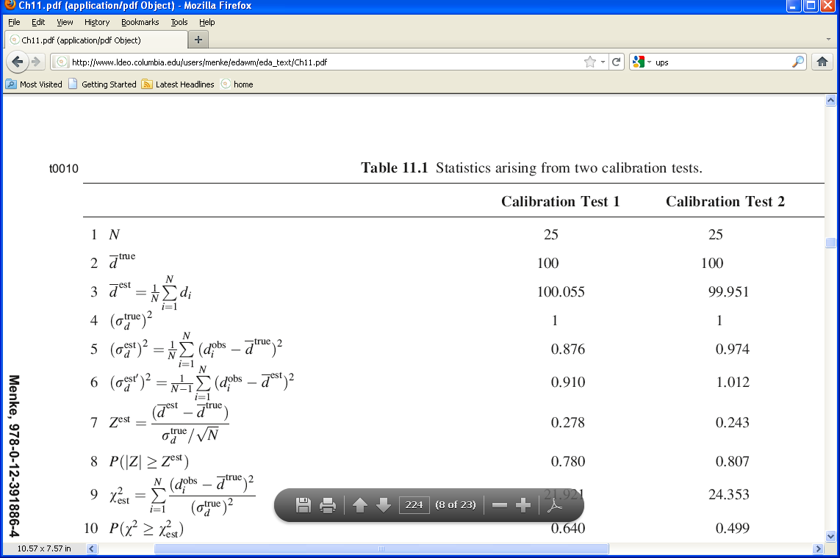
Results of Test 1
Notes:
Go though each of the lines.
The number of particles being measured.
The true diameters of the particles
The mean of the diameters that were actually measured, which is (slightly) different than the true mean
The ‘true’ variance, that is, the one stated by the manufacturer
The variance of the diameters of the 25 particle that you measured, assuming that their true mean of 100 is known.
The variance of the diameters of the 25 particle that you measured, assuming that you didn’t know their mean and
had to estimate it from the data. Note that the number of degrees of freedom is N-1, not N in this case.

Slide 35
Results of Test 2
Notes:
Results of the second test. You might flash back to the Test 1 slides, and compare the numbers.

Slide 36
Question 1 Is the Calibration Correct?
Null Hypothesis:
The observed deviation of the average particle size from its true value of 100 nm is due to random variation (as contrasted to a bias in the calibration).
Notes:
So the question is,
Is 100.055 and 99.951 significantly different from 100?

Slide 37
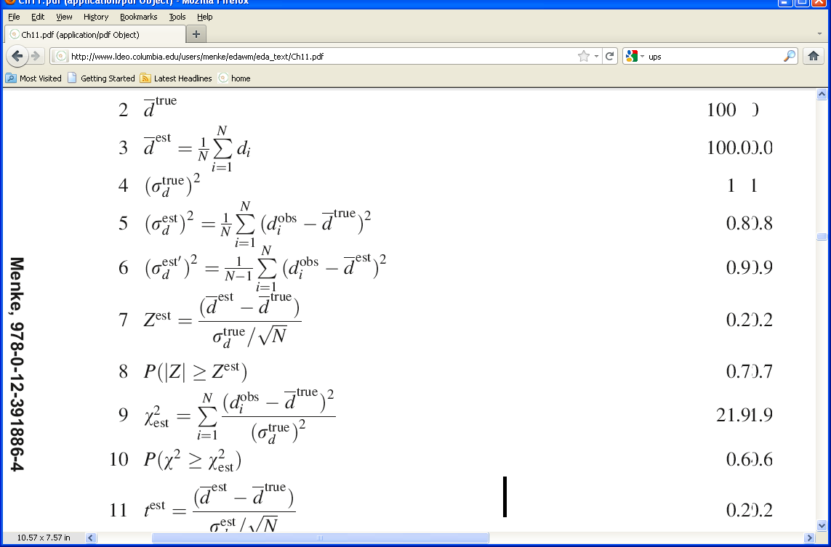
in our case
= 0.278 and -0.243
the key question is
Are these unusually large values for Z ?
Notes:
The Z statistic is Normal with zero mean and unit variance.
Here Z is the difference between the observed and true mean, normalized by the variance of the mean.
The probability that |Z| ≥ Z^{est} is large, much larger than 0.05, so the Null Hypothesis cannot be
rejected.
Point out the difference between
“There’s no reason to think the machine is biased”
and
“The machine is not biased”.

Slide 38
in our case
this is called
the standard error of the mean
(stdev / N^{1/2})
= 0.278 and -0.243
the key question is
Are these unusually large values for Z ?
Notes:
The Z statistic is Normal with zero mean and unit variance.
Here Z is the difference between the observed and true mean, normalized by the variance of the mean.
The probability that |Z| ≥ Z^{est} is large, much larger than 0.05, so the Null Hypothesis cannot be
rejected.
Point out the difference between
“There’s no reason to think the machine is biased”
and
“The machine is not biased”.

Slide 39
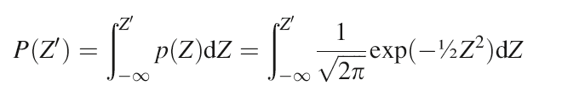
example for Normal (Z) distributed statistic P(Z’) is the cumulative probability from -∞ to Z’
called erf(Z')
p(Z)
Z
0
Z’

Slide 40
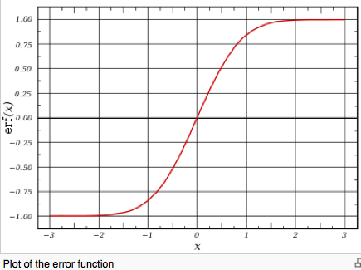
example for Normal (Z) distributed statistic P(Z’) is the cumulative probability from -∞ to Z’
called erf(Z')
p(Z)
Z
0
Z’

Slide 41
The probability that a difference of either sign between sample means A and B is due to chance is P( |Z| > Z^{est} ) This is called a two-sided test
p(Z)
Z
0
-Z^{est}
Z^{est}
which is
1 – [erf(Z^{est}) - erf(-Z^{est})]

Slide 42
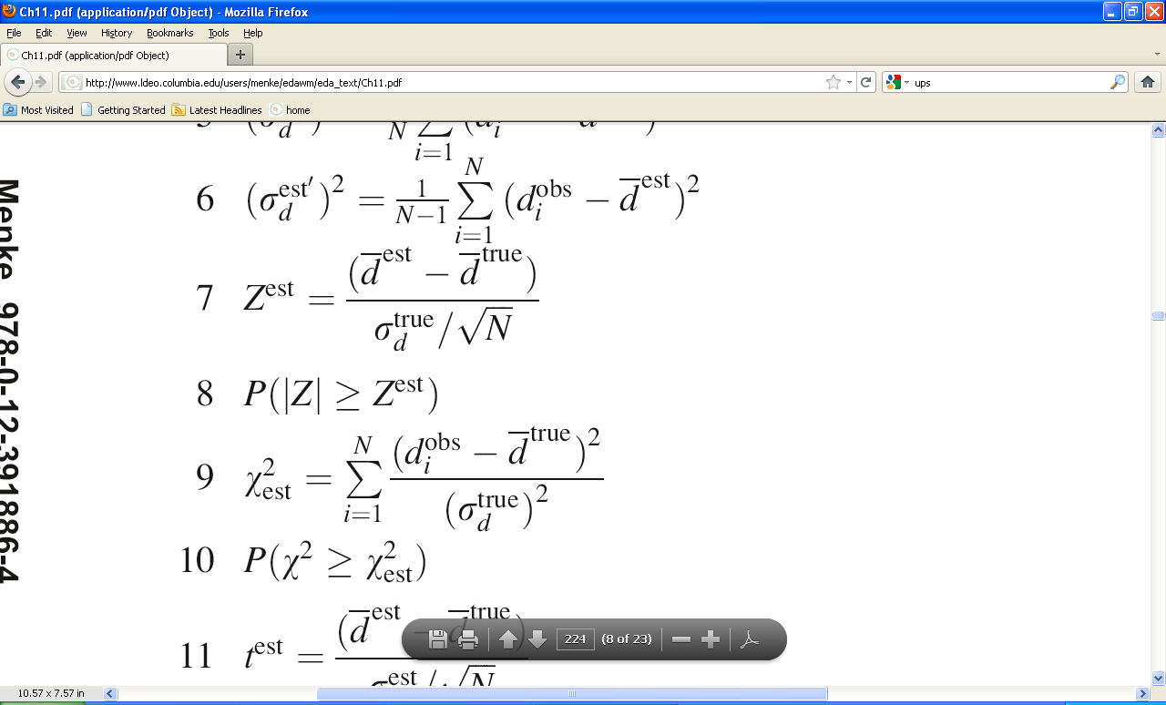
in our case
= 0.278 and 0.243
the key question is
Are these unusually large values for Z ?
= 0.780 and 0.807
So values of |Z| greater than Z^{est} are very common
The Null Hypotheses cannot be rejected.
There is no reason to think the machine is biased
Notes:
The Z statistic is Normal with zero mean and unit variance.
Here Z is the difference between the observed and true mean, normalized by the variance of the mean.
The probability that |Z| ≥ Z^{est} is large, much larger than 0.05, so the Null Hypothesis cannot be
rejected.
Point out the difference between
“There’s no reason to think the machine is biased”
and
“The machine is not biased”.

Slide 43
suppose the manufacturer had not specified that random measurement error is σ_{d} = 1 nm then you would have to estimate it from the data
= 0.876 and 0.894
Notes:
The point here is that if you have to
estimate a variance
then you are adding more random variation into the problem
for now you have two estimated quantities, mean and variance,
whereas before you just had one (mean)/

Slide 44
but then you couldn’t form Z since you need the true variance
Notes:
Z needs to be Normal.
If you replace the true variance with the estimated variance, then the resulting
quantity is not Normal.

Slide 45
we examined a quantity t, defined as the ratio of a Normally-distributed variable e and something that has the form of an estimated standard deviation instead of the true sd:
Notes:
Pont out that the quantity in the denominator is just the square root of the estimated
variance of a set of N Normall-distributed variables, each with zero mean and unit true variance.

Slide 46
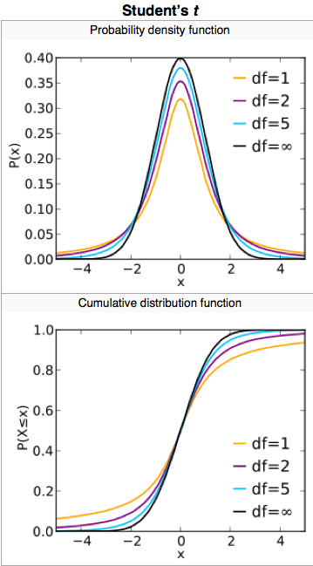
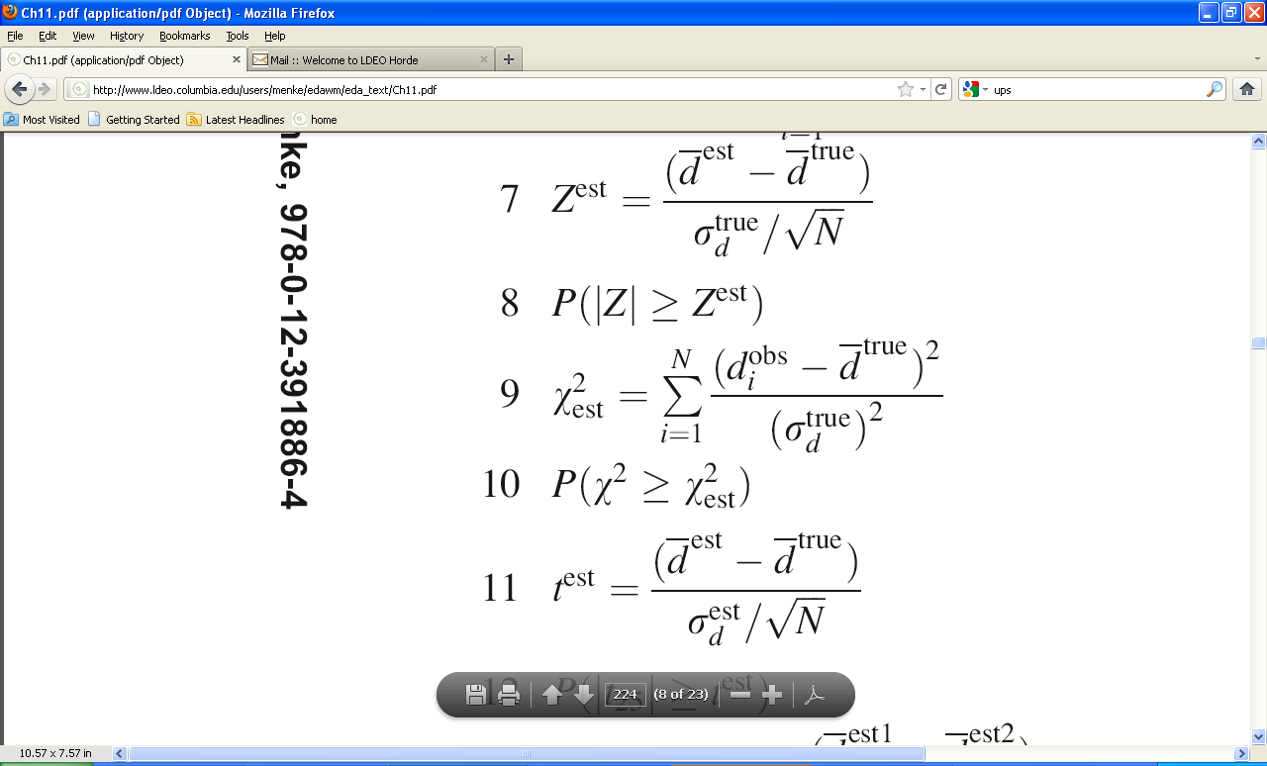
so we will test t
instead of Z
Notes:
Thus if you replace the true mean with the estimated mean, you get a
t-distributed variable.

Slide 47
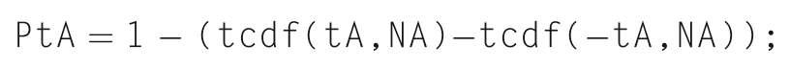
in our case
= 0.297 and 0.247
Are these unusually large values for t ?
Notes:
Point out that the MatLab function for the cumulative t-distribution
is tcdf(t, N)
where N is the degrees of freedom.

Slide 48
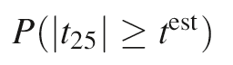
in our case
= 0.297 and 0.247
Are these unusually large values for t ?
= 0.768 and 0.806
= 0.780 and 0.807
So values of |t| > t^{est} are very common
(and verrry close to Z test for 25 samples)
The Null Hypotheses cannot be rejected
there is no reason to think the machine is biased
Notes:
Point out that the MatLab function for the cumulative t-distribution
is tcdf(t, N)
where N is the degrees of freedom.

Slide 49
Question 2 Is the variance in spec?
Null Hypothesis:
The observed deviation of the variance from its true value of 1 nm² is due to random variation (as contrasted to the machine being noisier than the specs).
Notes:
So the question is,
Is 0.876 and 0.974 significantly different from 1?

Slide 50
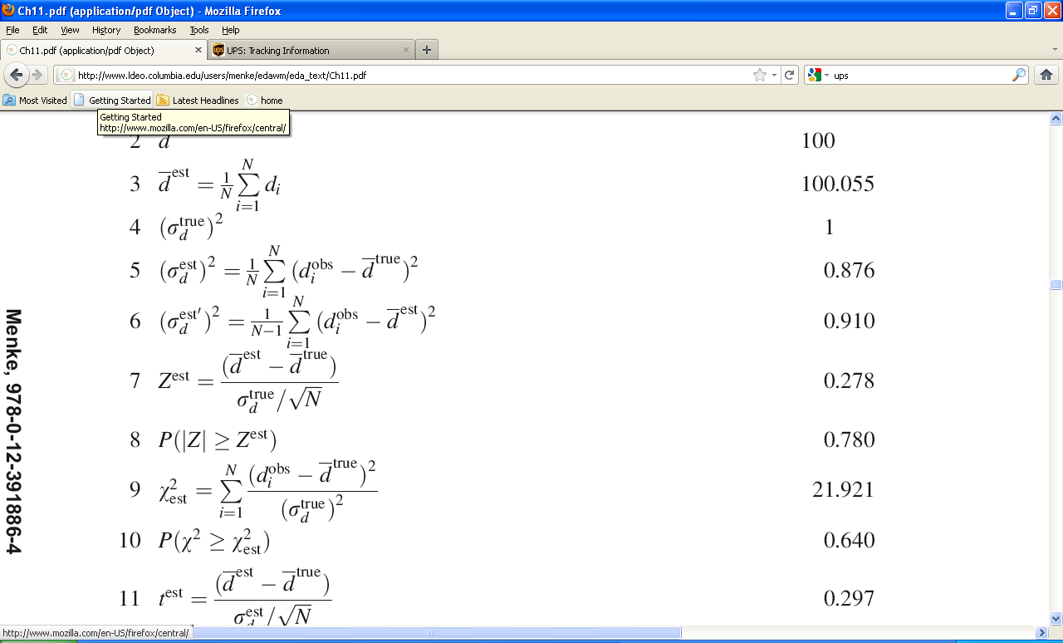
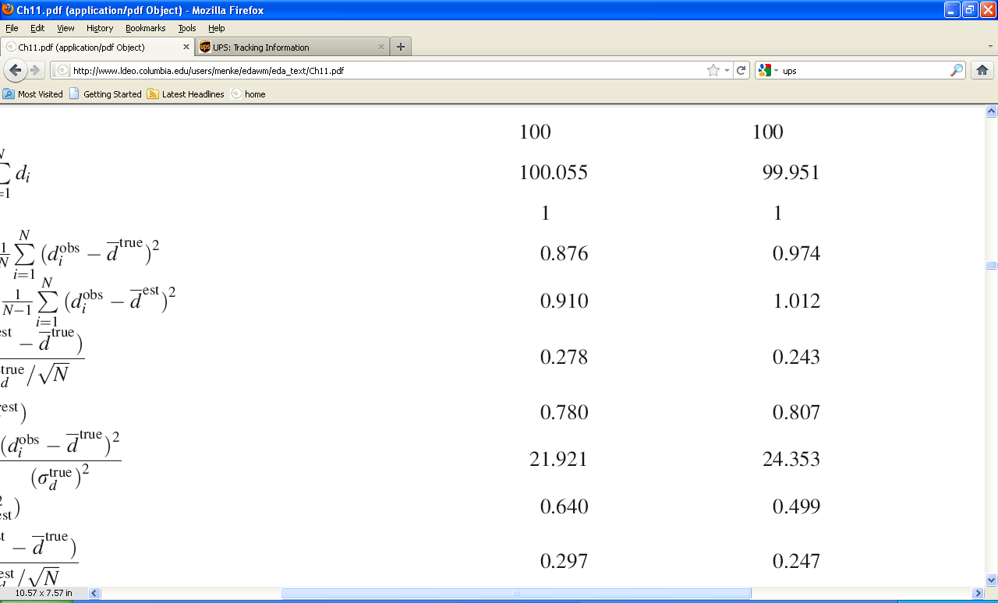
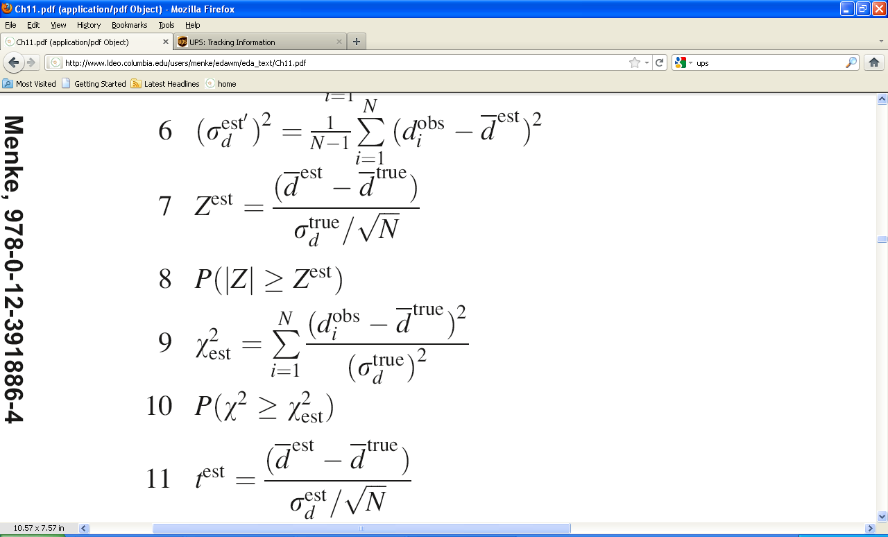
= ?
Results of the two tests
the key question is:
Are these unusually large values for χ²
based on 25 independent samples?
Notes:
The chi-squared statistic is one of the three non-Normal distributions that we discussed in the previous lecture.

Slide 51
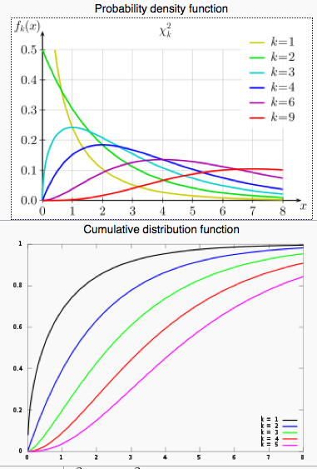
Are values ~20 to 25 unusual for a chi-squared statistic with N=25? Not at all: the median (p-value of 50%!) almost follows N

Slide 52
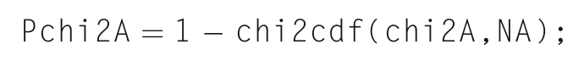
In MatLab
= 0.640 and 0.499
So values of χ² greater than χ_{est}² are very common
The Null Hypotheses cannot be rejected
there is no reason to think the machine is noiser than advertised

Slide 53
Question 3 Has the calibration changed between the two tests?
= 100.055 and 99.951
Null Hypothesis:
The difference between the means is due to random variation (as contrasted to a change in the calibration).
Notes:
The second mean is smaller than the first. Is it possible that the
machine’s “ruler” (internal length standard) is shrinking with time?
In my opinion, this is the single most useful Hypothesis test in all of data analysis.

Slide 54
since the data are Normal their means (a linear function) are Normal and the difference between them (a linear function) is Normal
Notes:
So the difference between the means can be normalized into a Z-distributed quantity.

Slide 55
since the data are Normal their means (a linear function) is Normal and the difference between them (a linear function) is Normal
if c = a – b then σ_{c}² = σ_{a}² + σ_{b}²
Notes:
This is just standard error propagation.
In our case, a and b are the two means
and c is their differrence.

Slide 56
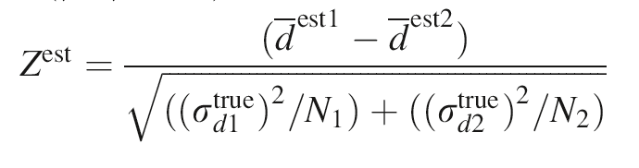
so use a Z test
in our case
Z^{est} = 0.368
Notes:
Note that this is a “new” definition of Z. It’s key attributes are that it is
Normally-distributed
has zero mean
and
has unit variance.

Slide 57
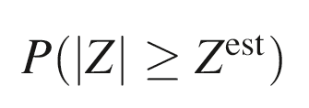
using MatLab
= 0.712
0.368
Values of |Z| greater than Z^{est} are very common
so the Null Hypotheses cannot be rejected
there is no reason to think the bias of the machine has changed
Notes:
Again, emphasize that
“There’s no reason to think that bias has changed”
is not the same as
“The bias has not changed”.
We cannot rule out that it changed. We can only state that there is no evidence that it changed.

Slide 58
Question 4 Has the variance changed between the two tests?
= 0.896 and 0.974
Null Hypothesis:
The difference between the variances is due to random variation (as contrasted to a change in the machine’s precision).
Or more to the point: The non-Unity ratio of the variances is due to random variation...
Notes:
Point out that the variance is larger in the second test. Perhaps the machine is getting “noisier”?

Slide 59
recall the distribution of a quantity F, the ratio of variances
Notes:
Point out that the numerator is just the
estimated variance of a set of N Normally-distributed variables, each with zero mean and unit true variance.
So is the denominator.
Hence F is ratio of variances, which is just what we want to test.
Also, point out that the individual summations are just chi-squared.

Slide 60
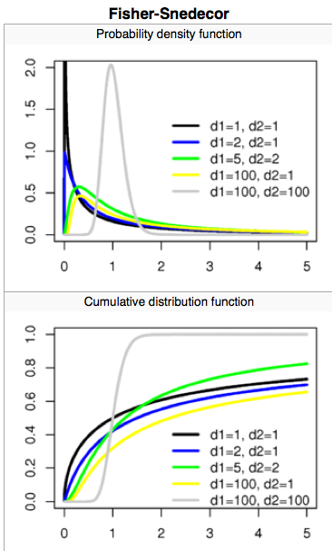
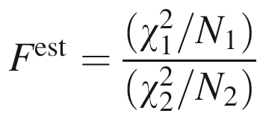
so use an F test
in our case
F ^{est} = 1.110
N1=N2=25
Notes:
Hence F can be computed from the chi-squared values that we previously computed.

Slide 61
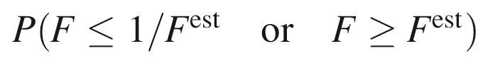
whether the top or bottom χ² in
p(F)
is the bigger is irrelevant, since our Null Hypothesis only concerns their being different. Hence we need evaluate the "two-sided" test:
F
1/F^{est}
F^{est}
Notes:
The tails of the distribution correspond to the case where one estimated variance is
much larger or much smaller than the other.
We want to know how much area is beneath the tails.

Slide 62
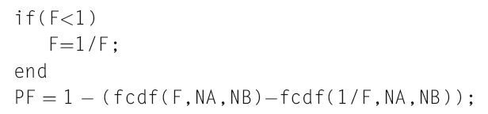
using MatLab
1.11
1.11
= 0.794
Values of F so close to 1
are very common even with N = M = 25
so the Null Hypotheses cannot be rejected
there is no reason to think the noisiness of the machine has changed
Notes:
The conditional in the m-script assures that 1/F is smaller than F.

Slide 63
Another use of the F-test
Notes:
This ends the machine scenario.
Note that I’ve left out one Null Hypothesis that is worked through in the text
(comparing difference in means when true variance is unknown, so t-test is used).
it would make the lecture too long.

Slide 64
we often develop two alternative models to describe a phenomenon and want to know which is better?
Notes:
In my opinion, this is the second most useful test in all of data analysis
(the first being the test of difference between two means).

Slide 65
A "better" model? look for difference in total error (unexplained variance) between the two models Null Hyp: the difference is just due to random variations in the data

Slide 66
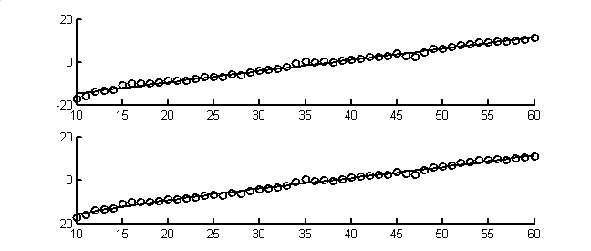
Example
Linear Fit vs. Cubic Fit?
linear fit
d(i)
time t, hours
cubic fit
d(i)
time t, hours
Notes:
The cubic fit is only a little better than the linear fit.
See if the students can pick up on any subtle differences.

Slide 67
Example
Linear Fit vs Cubic Fit?
A) linear fit
d(i)
time t, hours
B) cubic fit
d(i)
cubic fit has 14% smaller summed error, E
time t, hours
Notes:
The cubic fit is a little better near the left side of the plot, leading to 14% reduction in total error
relative to the linear fit.

Slide 68
The cubic fits 14% better, but …
the difference could just be due
to random variation
and furthermore
The cubic has 4 coefficients, the line only 2, so the error of the cubic will tend to be smaller anyway
Notes:
The second issues, the different number of coefficients, if corrected for during the calculation of
degrees of freedom.

Slide 69
Use an F-test
degrees of freedom on linear fit:
ν_{L} = 50 data – 2 coefficients = 48
degrees of freedom on cubic fit:
ν_{C} = 50 data – 4 coefficients = 46
F = (E_{L}/ ν_{L}) / (E_{C}/ ν_{C}) = 1.14
Notes:
Technically, we should be normalizing E by the true variance of the measurements,
that is E → E/σ_{d}²
to yield a variable with unit variance.
However, the factor of 1/σ_{d}² appears in both numerator and denominator, and cancels out.

Slide 70
so use an F test
in our case
F ^{est} = 1.14
N1,N2 = 48, 46
Notes:
Hence F can be computed from the chi-squared values that we previously computed.

Slide 71
in our case
= 0.794
Values of F greater than F ^{est} or less than 1/F ^{est}
are very common
So the Null Hypothesis
(that there is no reason to believe a cubic term improves the model) cannot be rejected.

Slide 72
Degrees of freedom
All the finite-sample tests depend on how many degrees of freedom (DOFs) you assume.
In some applications, every sample is independent so #DOFs = #samples
In a lot of our work this isn't true!
e.g. time series have "serial correlation"
“Noise” like: DOFs ~ T / (autocorrelation peak width)
“Wave” (Fourier): 2 DOFs per frequency
Parametric significance hinges on DOFs
Hazard! This is why you should kick your data around a lot before falling back on these canned tests.
http://en.wikipedia.org/wiki/Degrees_of_freedom_(statistics)

Slide 73
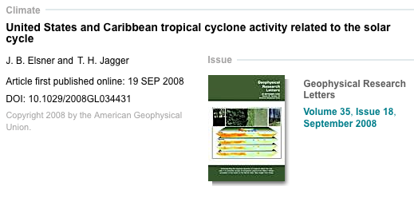
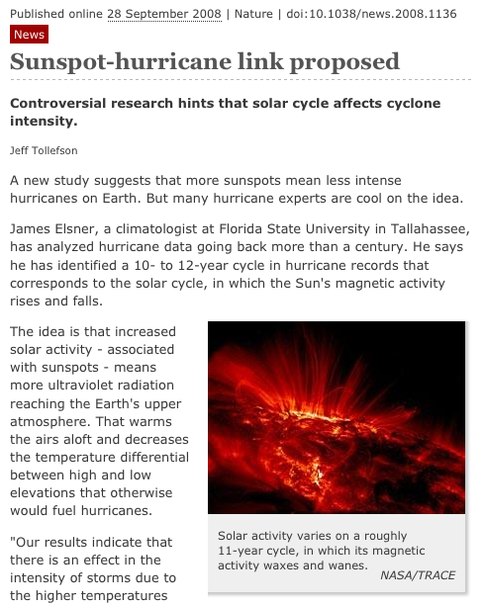
Sunspots and hurricanes
http://onlinelibrary.wiley.com/doi/10.1029/2008GL034431/pdf

Slide 74
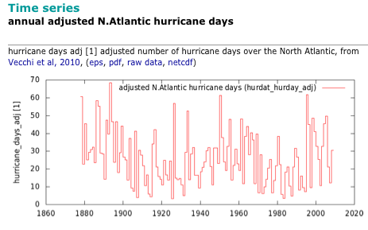
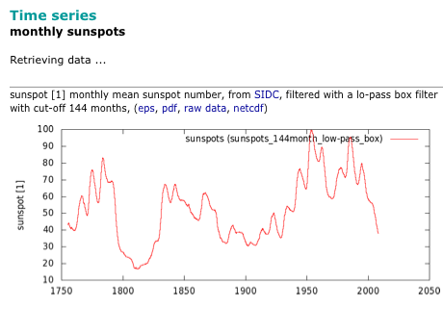
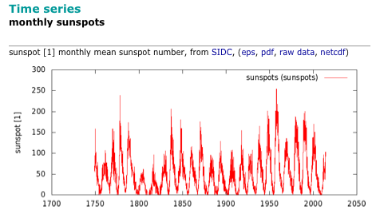
Dangerous datasets: two freqs
low pass filter of sunspots

Slide 75
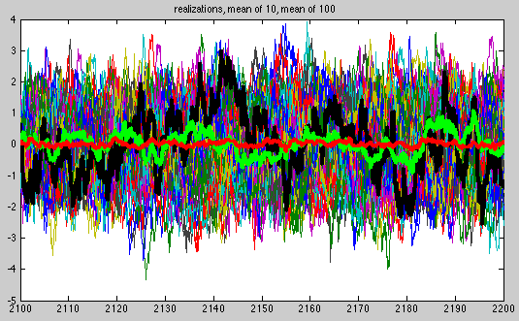
Statistical tests assume red noise

Slide 76
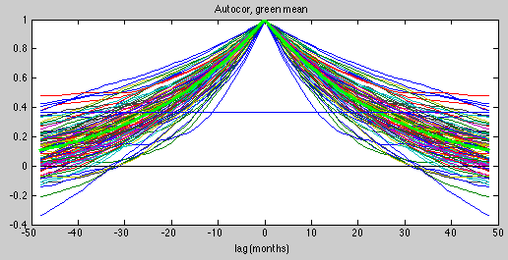
"Effective degrees of freedom": time series length/ autocor decay time
lag at which correlation decays to 1/e
or maybe twice that (typical excursion duration)?
seems to work better for 1x decay time
25 months
1200/25 = 40

Slide 77
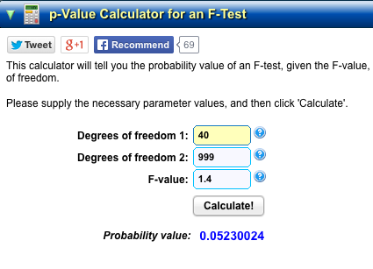
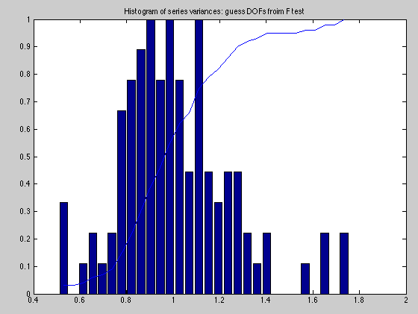
Random fluctuations in 100y variances relative to the true (var=1) process
Notes:
http://www.danielsoper.com/statcalc3/calc.aspx?id=7

Slide 78
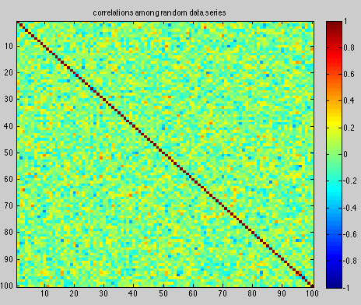
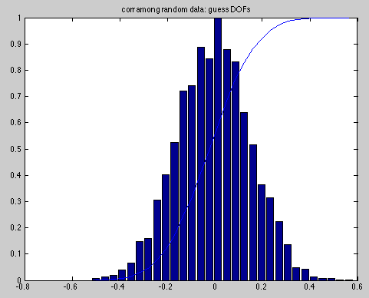
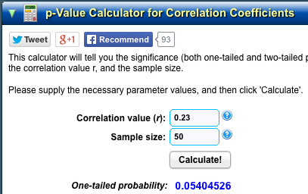
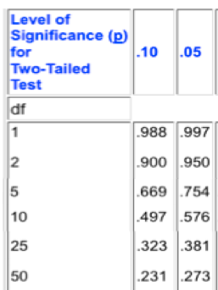
Random correlations of 100y series
~50 DOFs implied
Notes:
http://www.danielsoper.com/statcalc3/calc.aspx?id=44

Slide 79
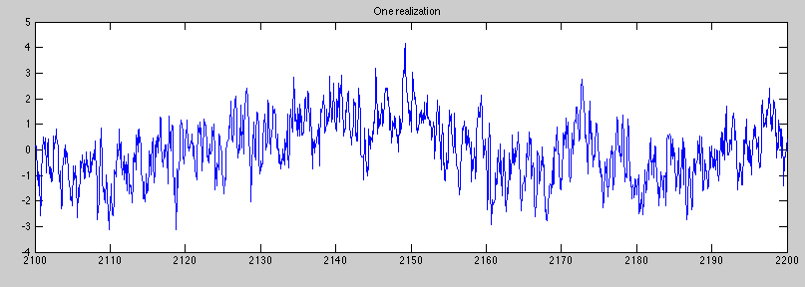
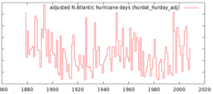
Danger: Low + high freq mixtures
data = (0.6*AR1 + 0.4*LFAR1) *sqrt(2); % Weighted sum, var=1

Slide 80
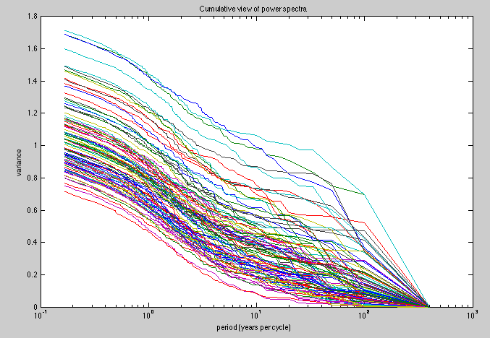
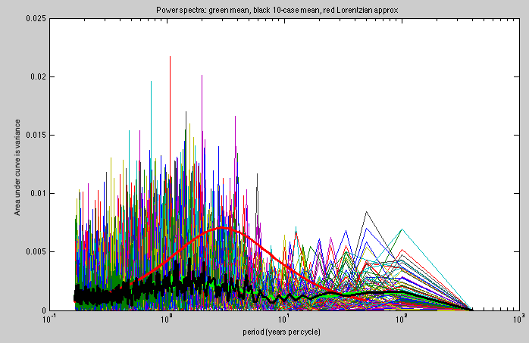
LF + HF mixture in spectrum...
HF part
LF part

Slide 81
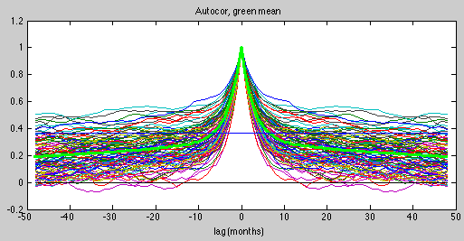
Long tailed autocorrelation: so the e-folding time isn't the whole story!
1200/10 ~ 120 DOFs? DANGER

Slide 82
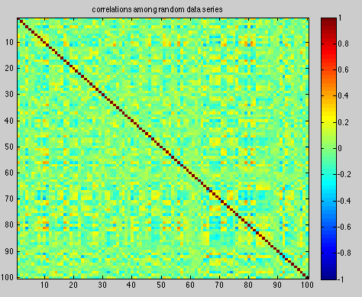
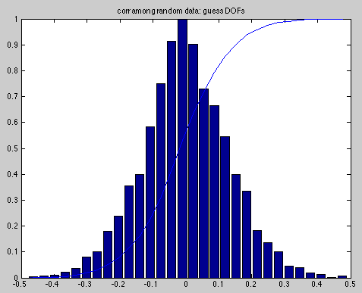

Spurious correlations are 10x more likely than you would expect from 120 DOFs!

Slide 83


Spurious covariance is usually in the low frequencies (long periods), which have just a few DOFs (& are prone to coincidences)
While high frequencies contribute the large number of (apparent! by standard formula) effective degrees of freedom

Slide 84
413! Daily relationship!
"The rank correlation between daily sunspot number and daily averaged tropical cyclone intensity for all tropical storms and hurricanes in the domain over the period 1944–2006 is −0.11 (P < 0.001, 413 degrees of freedom). The significance includes a reduction in the degrees of freedom since daily intensities and SSN are serially correlated."
United States and Caribbean tropical cyclone activity related to the solar cycleAuthors• J. B. Elsner,• T. H. Jagger• DOI: 10.1029/2008GL034431

Slide 85



Slide 86

t-test for correlations (between variables satisfying a bunch of standard assumptions...)

Slide 87
A cautionary tale
Unnamed young assistant professor (and several senior coauthors)
Studying year to year changes in the western edge of North Atlantic subtropical high (NASH)
Important for climate impacts (moisture flux into SE US, tropical storm steering)
Watch carefully for null hypothesis...

Slide 88




- global T
-Z850’ at FL panhandle &9y smooth
-PDO 9y smooth
-PDO + ¼ AMO 9y smooth
“We thoroughly investigated possible natural causes, including the Atlantic Multidecadal Oscillation (AMO) and Pacific Decadal Oscillation (PDO), but found no links...Our analysis strongly suggests that the changes in the NASH [Z850'] are mainly due to anthropogenic warming.”
This claim fails the eyeball test, in my view

Slide 89

The evidence (mis)used:
"Are the observed changes of the NASH caused by natural climate variability or anthropogenic forcing? We have examined the relationship between the changes of NASH and other natural decadal variability modes, such as the AMO and the PDO (Fig. 2). The correlation between the AMO (PDO) index and longitude of the western ridge is only 0.19 (0.18) and does not pass significance tests. Thus, natural decadal modes do not appear to explain the changes of NASH. We therefore examine the potential of anthropogenic forcing..."
unsmoothed indices, yet the word "decadal" is in the name →

Slide 90


The evidence (mis)used:
The correlation between the AMO (PDO) index and longitude of the western ridge is only 0.19 (0.18) and does not pass significance tests. Thus, natural decadal modes do not appear to explain the changes of NASH.
This is factually correct (table): correlation would have to be 0.25 to be significantly (at 95%) different from zero, with 60 degrees of freedom (independent samples).

Slide 91

Degrees of freedom error
Do we really have 60 degrees of freedom of these "decadal" indices in 60 years?
The non-decadal variability (noise in the index) reduces correlation coefficient.
It also shortens the decorrelation time so that DOF~ 60y/(t_{decor}) ~60, making

Slide 92
Logical flaw: Null hypothesis misuse
"Hypothesis:" that PDO explains Z850 signal
but this is really their anti-hope, one senses
"Null hypothesis:" that PDO-Z850 correlation is really zero, and just happens to be 0.18 or 0.19 due to random sampling fluctuations
t-test result: Cannot reject the null hypothesis with 95% confidence (with dof sleight of hand)
Fallacious leap: Authors concluded that the null hypothesis is true, i.e. "no links" to PDO.
Further leap: "Our analysis strongly suggests that the changes in the NASH are mainly due to anthropogenic warming." – but that is another story.

Slide 93

Flaw in the spirit of "null"
Their true "hope-othesis" (as deduced from enthusiasm in press release): that a trend is in the data, inviting extrapolation into the future.
A true Nullification of that: That previously described natural oscillations suffice to explain the low frequency component of the data (oatmeal)
The ultimate test: eyeball

Slide 94
Subtler point: spectral view of DOFs in time series Use smoothing to isolate "decadal" part of noisy "indices" (pattern correlations, defined every day)
-Z850’ at FL panhandle &9y smooth
-PDO 9y smooth
-PDO + ¼ AMO 9y smooth
The correlation of these smoothed curves would be much higher than 0.19, but with only ~2 DOFs.
Beware very small N like that! Trust your eyes at that point, not a canned test.
The correlation between the AMultidecadalO (PDecadalO) index and longitude of the western ridge is only 0.19 (0.18) and does not pass significance tests. Thus, natural decadal modes do not appear to explain the changes...

Slide 95





Went wrong from step 0 (choice of variable to study)
Z850'
psi'

Slide 96

v850' (the real interest)

Slide 97




